Slide 1
Product Vision:
AKMU launches a new website to meet fans’ interactive needs and employers’ artist research
The website gives various AKMU’s personal touch that gives fans more connections to the artist and have easy access for future musical employers.
Nov. 9, 2019 – AKMU today announced their own brand-new website that encompasses many features for their fans and future event organizers. Where the old website had only banal information about AKMU, this website has connection to AKMU’s social media, bi-weekly interview of upcoming event/album, online Live Concert, AKMU’s personal Vlogs, and monthly event of creating songs with their fans live. For show organizers, the website gives AKMU’s schedule, direct contact information for hire and updates on recent activities. The old website lacked connectivity from fans to the artist and lack of information for employers, and this new website has created contents that stirs up interaction and specific information.
“As an avid fan of AKMU, it always has been a frustration from the fan point of view of having the old website in the YG entertainment’s main website. The newly separated website has given me such more freedom to have a say as a fan in the comment section. The online live concerts are amazing, since I am not able to make all the concerts in person, and having to make a song with the artist was such an experience! I am not only a fan but can be a muse to the artist! The bi-weekly interviews are an improvement, since the newsfeed of their updates in text-form is always boring.”
Say good-bye to outdated ideas, and hello new contents. With this introduction of AKMU’s website, please enjoy the new features, connect with the artists, and send us other interactive ideas.
https://spark.adobe.com/page/kYrfTr4izdk3u/

Slide 4
Connect on Social Media
Capability
Visit Website
Choose Social Media
View Pictures/ Videos
Like Pictures
Write Comments
Steps
Navigate to Social Media Tab
View Brother: Lee Chan Kyuk’s Instagram
Scroll Down
Double click on Picture
Click on text box
Features
View Sister: Lee Su Hyun’s Instagram
Click on Pictures
Click heart
Type comments
Activities
Enablers
Instagram Database
NFRs
Reliability/
Portability
Usability/ Portability
Usability
Personalizability
Personalizability
Two Instagram information
Picture/ Comment information
Data

Slide 5
View
Bi-weekly Interview
Capability
Visit Website
Search Interview
View Interview
Write Comments
Steps
Navigate to Interview Tab
Search by Date
Select Video
Click on Text Box
Features
Search by Event
View Interview
Write Comments
Activities
Enablers
Interview Database
Video Database
NFRs
Reliability
Usability
Usability
Personalizability
Interview information
Video information
Data

Slide 6
View
Online Live Concert
Capability
Visit Website
Search Live Concert Time
View Live Concert
Write Comments
Steps
Navigate to Live Concert Tab
Search by Live Concert Time
Select Play
Click on Text Box
Features
View Concert
Write Comments
Activities
Enablers
Date & Time Data
Live Concert Hosting
=]
NFRs
Reliability
Usability
Administrability
Personalizability
Live Concert Schedule Information
Live Concert information
Data

Slide 7
View
Vlog
Capability
Visit Website
Search Vlog
View Vlog
Write Comments
Steps
Navigate to Vlog Tab
Scroll Down to View Update
Select Play
Click on Text Box
Features
View Vlog
Write Comments
Activities
Enablers
Vlog Data
=]
NFRs
Reliability
Usability
Usability
Personalizability
Data
Vlog Information

Slide 8
Create Song with AKMU
Capability
Visit Website
View Album Theme by AKMU
View Work in Progress Songs
View Drafted Song by AKMU
View Final Song
Steps
Navigate to Song Tab
Select Theme Article
Select Song Beats / Melody updated by other fans
Navigate to Draft Song
Navigate to Final Song
Features
Read Theme
Listen to Beats / Melody
Select Draft Song
Select Final Song
Activities
Upload Created Beats / Melody
Listen to Draft Song
Listen to Draft Song
Enablers
Text Data
Song Data
Draft Song Data
Final Song Data
=]
NFRs
Reliability
Usability
Usability / Personalizability
Usability
Usability
Text Information
Song / Melody information
Draft Song information
Final Song information
Data

Slide 9
Make Suggestions
Capability
Visit Website
Browse All Suggestions
Write Suggestions
Steps
Navigate to Suggestion Tab
Scroll Down to View Suggestions by other Fans
Select suggestion section
Features
Write Suggestions
Activities
Enablers
Suggestion Data
=]
NFRs
Reliability
Usability
Personalizability
Data
Suggestion Information

Slide 10
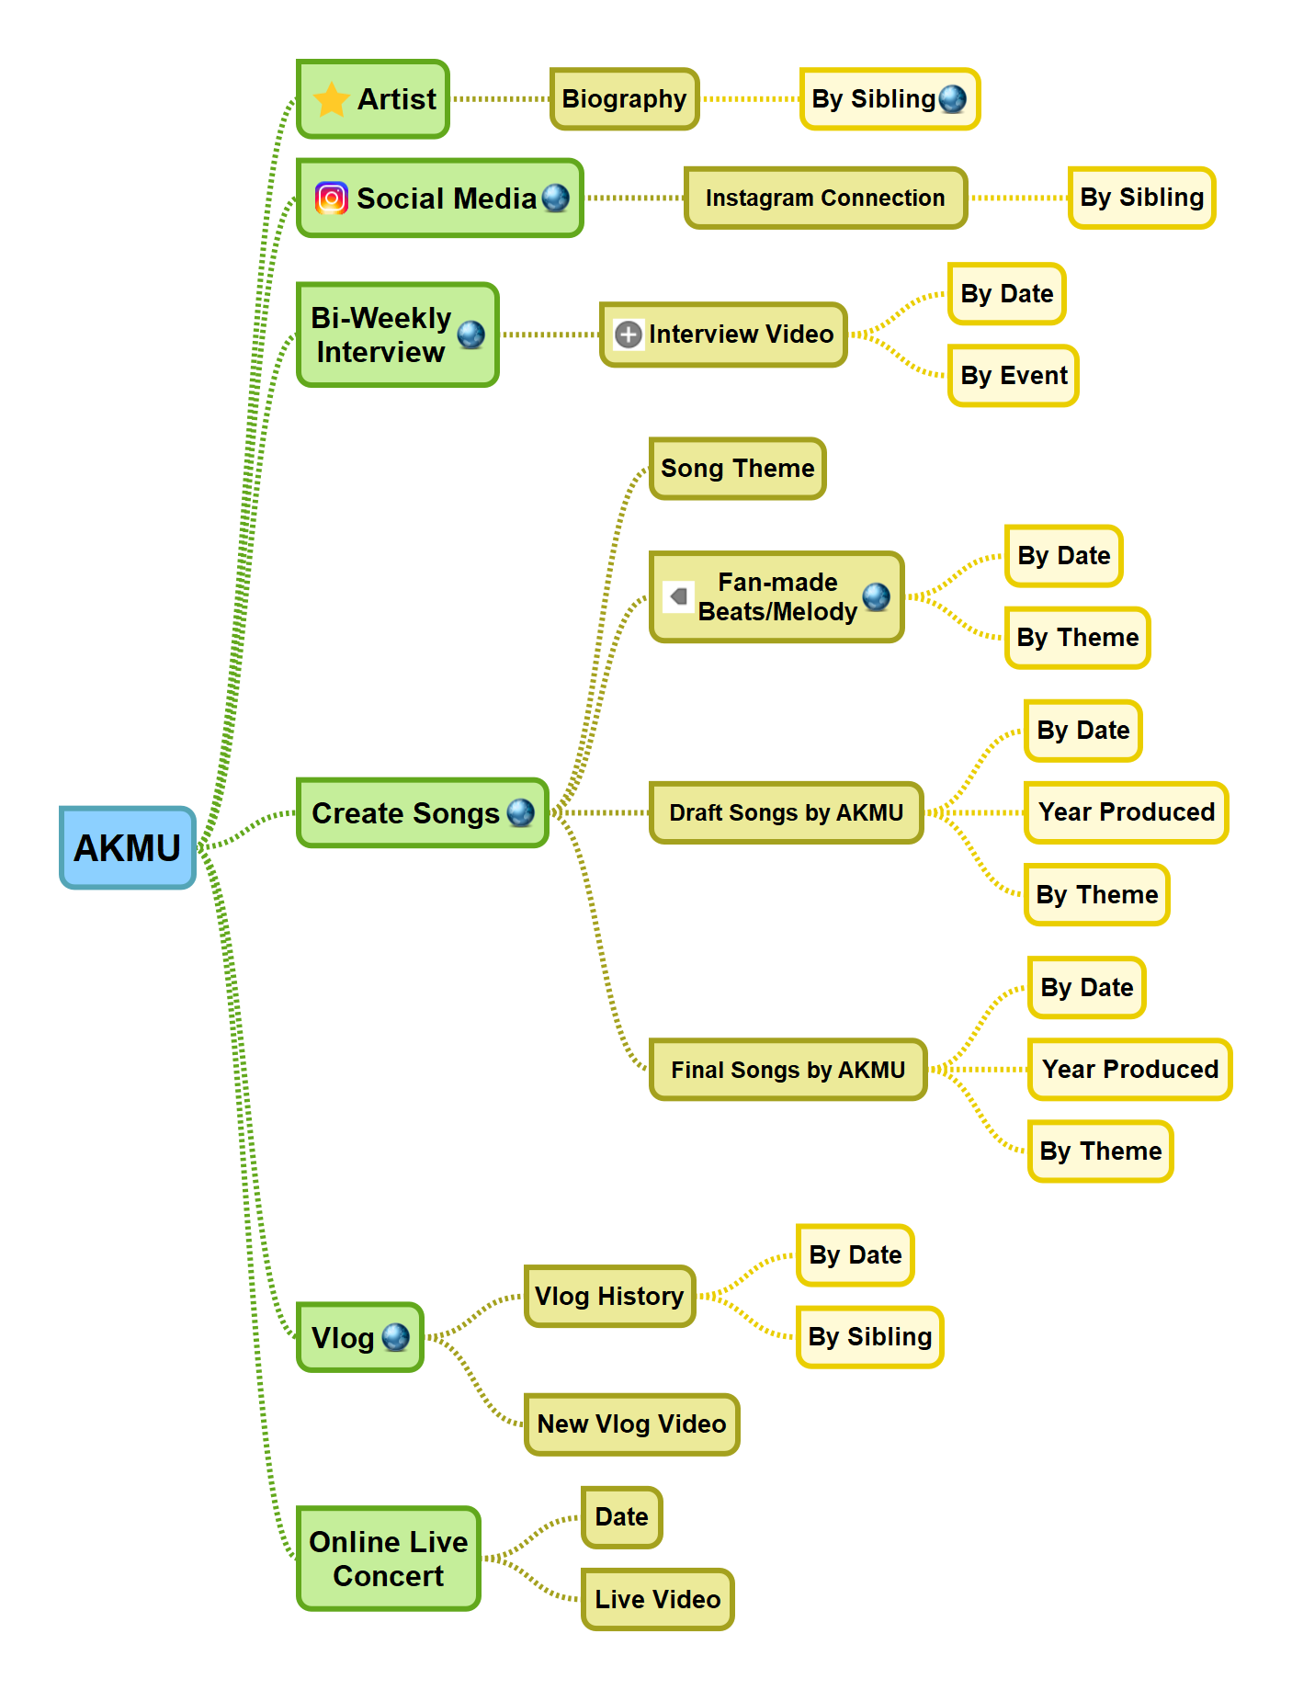
Content Map:

Slide 11
Backlog & Roadmap:
https://trello.com/b/bhY8clSx/cs634group3joshuayoon

